Slide 1
Topic:Applying Fractions, decimals & percentages EQ: How do you apply Fractions, decimals and Percentages in real life?
Year 11 Essentials

Slide 2
Things Required For This Lesson
Interactive Notebook
Textbook: Interleaved Maths Essential Connections
Ruler, Red Pen, Pencil, Pens, Scientific Calculator
Growth mindset

Slide 3

24
7
30
Topic: Fractions, decimals and percentages
Date: 12/02/2021
EQ: How do you apply Fractions, decimals and Percentages in real life?
WICOR
This Photo by Unknown Author is licensed under CC BY-SA

Slide 4

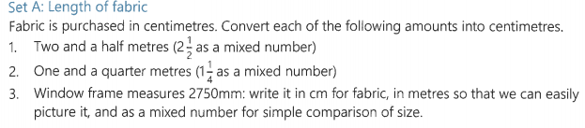
Questions page 19 set A

Slide 5
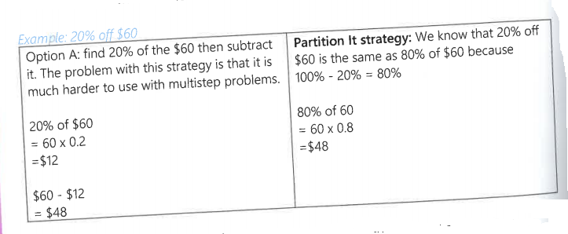
24
7
30
Topic: Fractions, decimals and percentages
EQ: How do you apply Fractions, decimals and Percentages in real life?
Percentages, fractions or decimals of amounts
“of” means to multiply, so you just need to multiply the amount by the percentage, fraction or decimal
Example: 80% of 120
80%=0.8, so 0.8x120 = 96
You can use your calculator
EXAMPLE Find 20% off $60
Discounts
WICOR

Slide 6
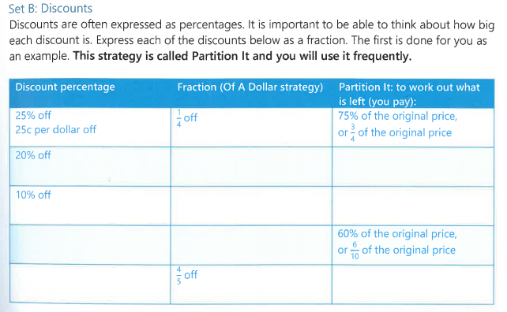

Slide 7
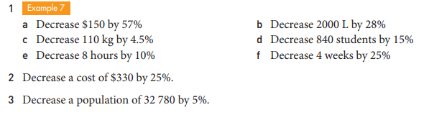
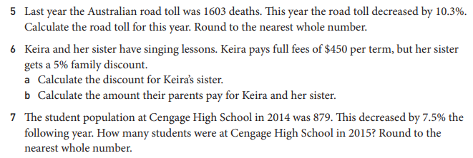

Slide 8

Thank you
Keep up the good work!
Quote of the day –
“No, I am your father”- Darth Vader

